Slide 1
Iron Out the Kinks
Aaron Heiss
Postdoctoral Fellow, Eunsoo Kim Laboratory
Department of Invertebrate Zoology
American Museum of Natural History

Slide 2
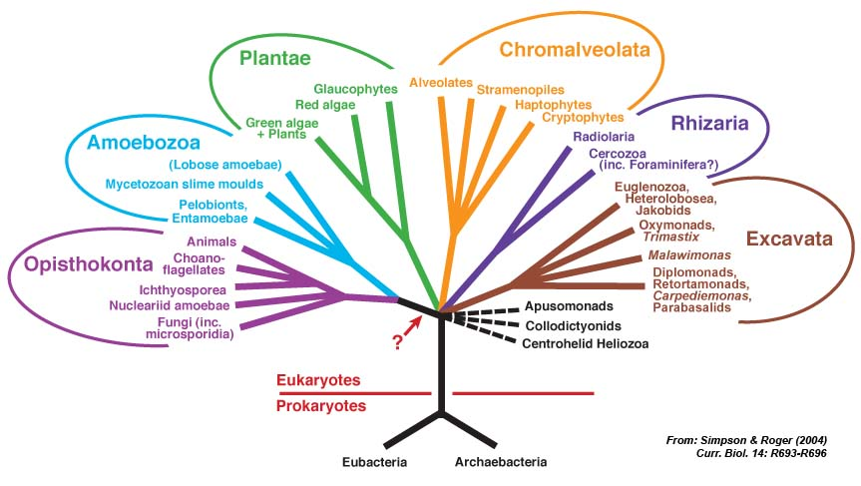
An Evolutionary Tree of All Life
Archaeplastida
YOU ARE HERE
Notes:
“You are here” = you, me, my cat, sharks, beetles, clams, and jellyfish — all of that diversity, packed into one word.

Slide 3
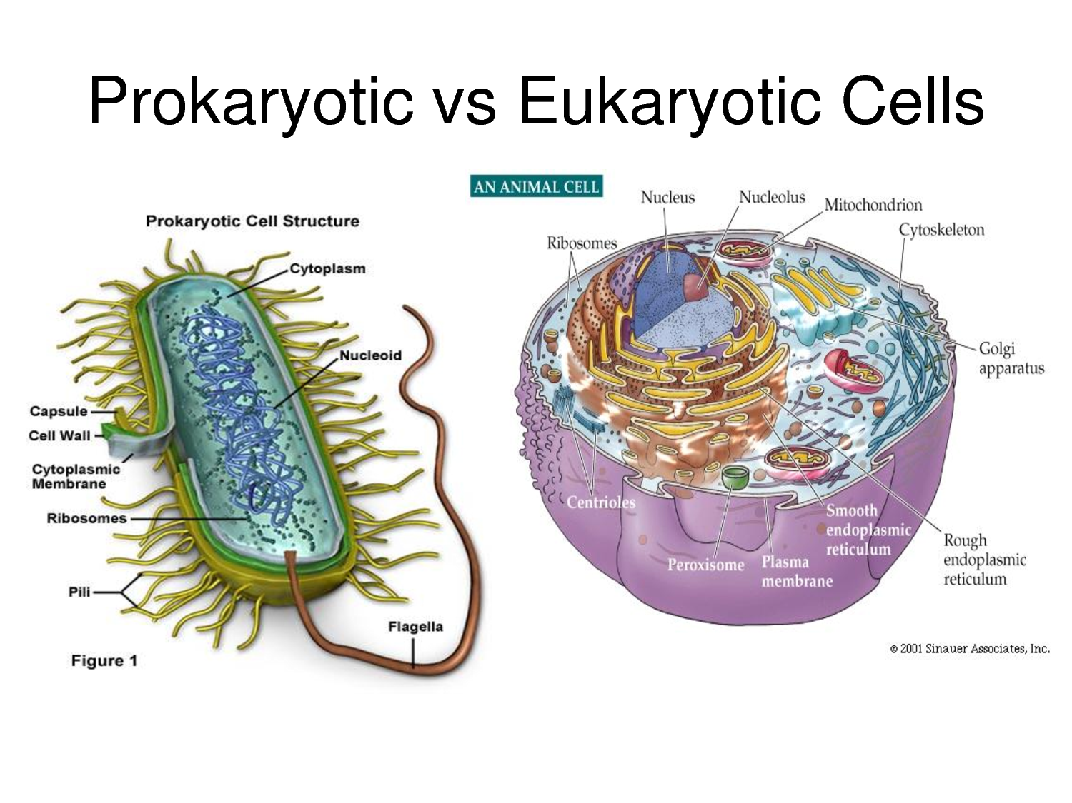
Prokaryote vs Eukaryote
Notes:
This is deceptive: the two cell types appear merely to be different flavours of the same kind of complicated.

Slide 4
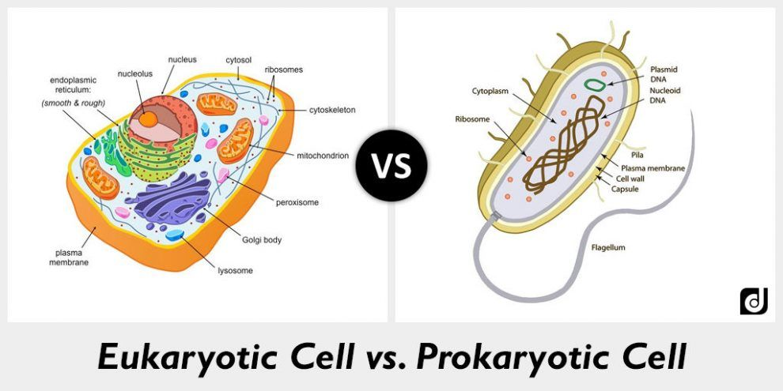
Notes:
A bit better, but still undervalues the qualitative difference between these things.

Slide 5
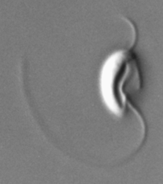
The Flagellar Apparatus

Slide 6
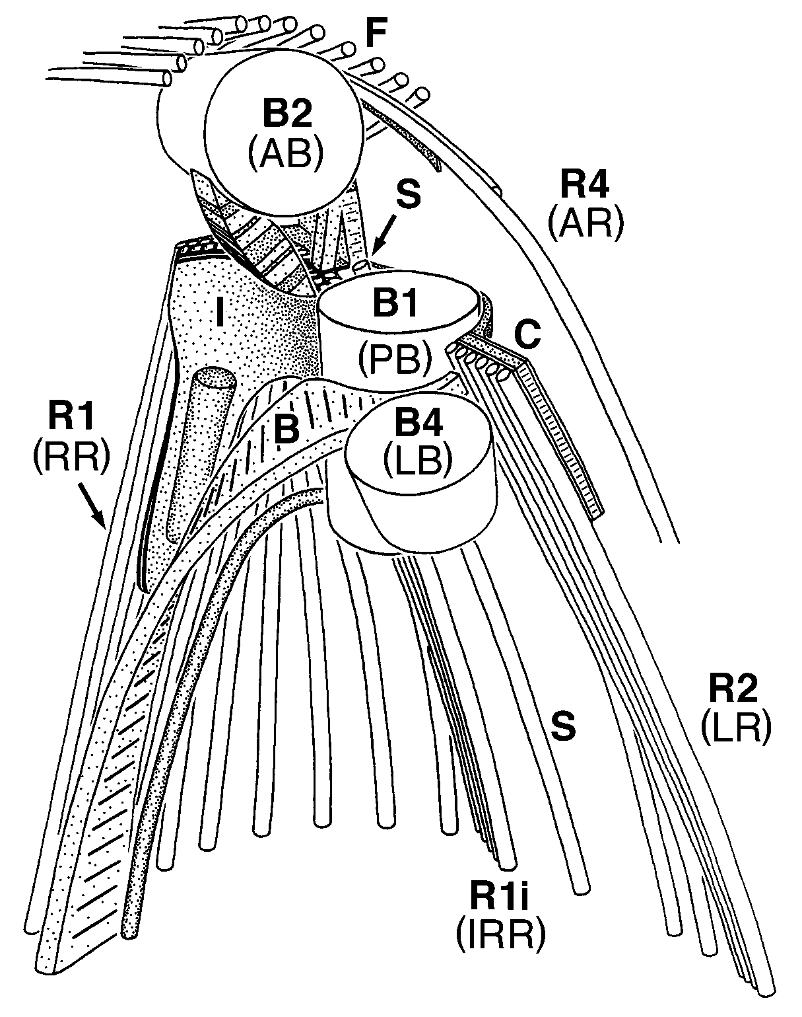
The Flagellar Apparatus
Simpson 2003, IJSEM 53:1759-77

Slide 7
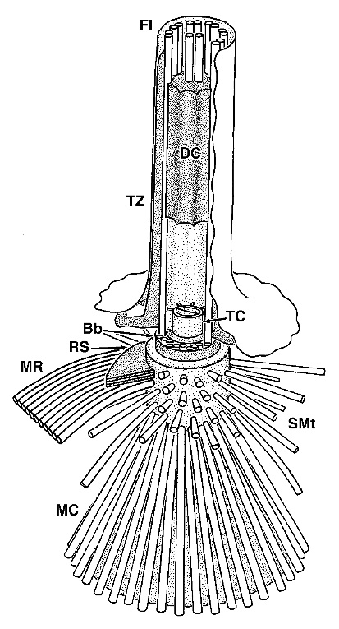
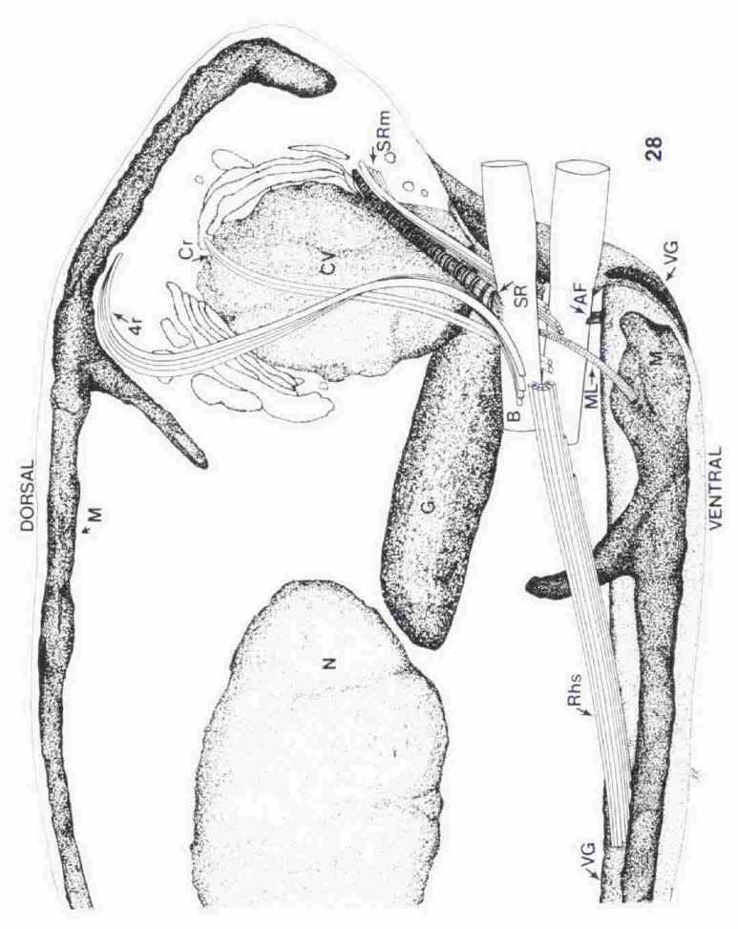
The Flagellar Apparatus
‘bikont’
(Cryptomonas)
‘unikont’
(Mastigamoeba)
Walker &a 2001, Eur J Prot 37:25–49
Roberts 1984, J Phycol 20:590–9

Slide 8
An Evolutionary Tree of All Life
Archaeplastida
YOU ARE HERE

